Slide 1
Skill development project
Project Name: E-Commerce
Website Name:
Tout
--Every Thing At One Place

Slide 2
Skill development project
> Batch-20
ID Number | Name
190031397 | RANGU JYOTHI SRI
190031403 | R SRI NAGA HARISHA
1900031528 | SIVA GANESH CH
190031505 | SHAIK RIYAZ BASHA
190030311 | CHILUKA YASHWANTH

Slide 3
User-Stories
Title: signUp Button
As a 'newuser' I want 'to create my new account' So that 'I can save my delivery details in your website'.
Title: Navigation Bar
As a 'user' I want 'list of all products' So that 'I can know all types of products available in website'.
Title: Add to cart Button
As a 'user' I want 'Add to cart option' So that 'I can keep tract of products I want to buy'.
Title: Receving Updates Regarding Offers
As a 'regularuser' I want 'Updates of Offers' So that 'I can save my money while purchasing products online'.
Title: ChatBot
As a 'user' I want 'to contact Support Team' so that 'my problems or queries get resolved quickly'.

Slide 4
User-stories
Title: Voice Assistent
As a ‘customer' I want 'voice Search feature' so that 'I can search my product without typing'.
Title: Slieshow of top Products and offers on top of webpage
As a 'user' I want 'slideshow of offers and Products' So that 'I can find them easily after visiting homepage'.
Title: Filtering products based on Price
As a 'user' I want 'only proucts displayed that fit my budget' So that 'I can decide to buy the product or not'.
Title: Filtering products based on brand
As a 'User' I want 'products of particular brands only' so that 'I can find product of my favourite brand'.
Title: Paying With Debit/Credit cards.
As a 'user' I want 'online paymet option' So that 'I can pay money through netbanking or with Credit/Debit cards'.

Slide 5
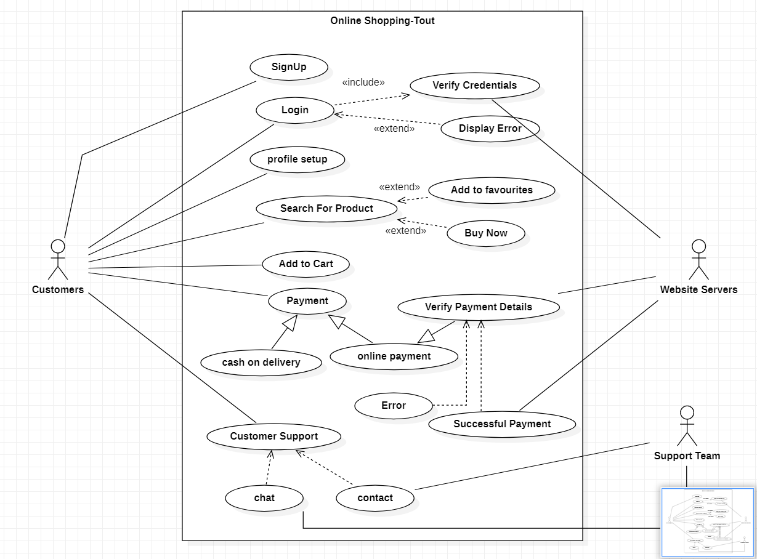
Use-Case Diagram

Slide 6
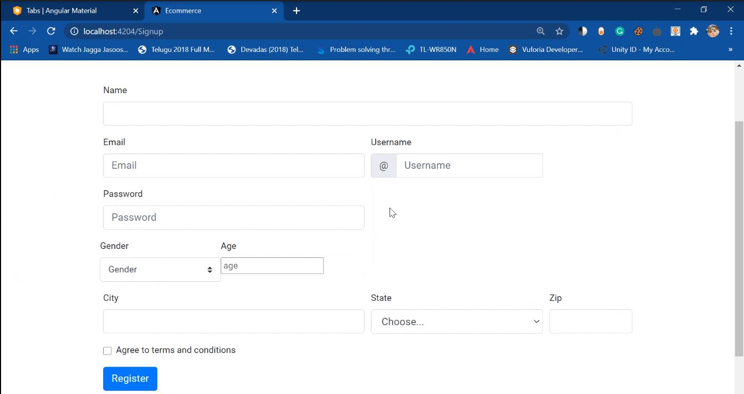
Sign-up/register page:

Slide 7
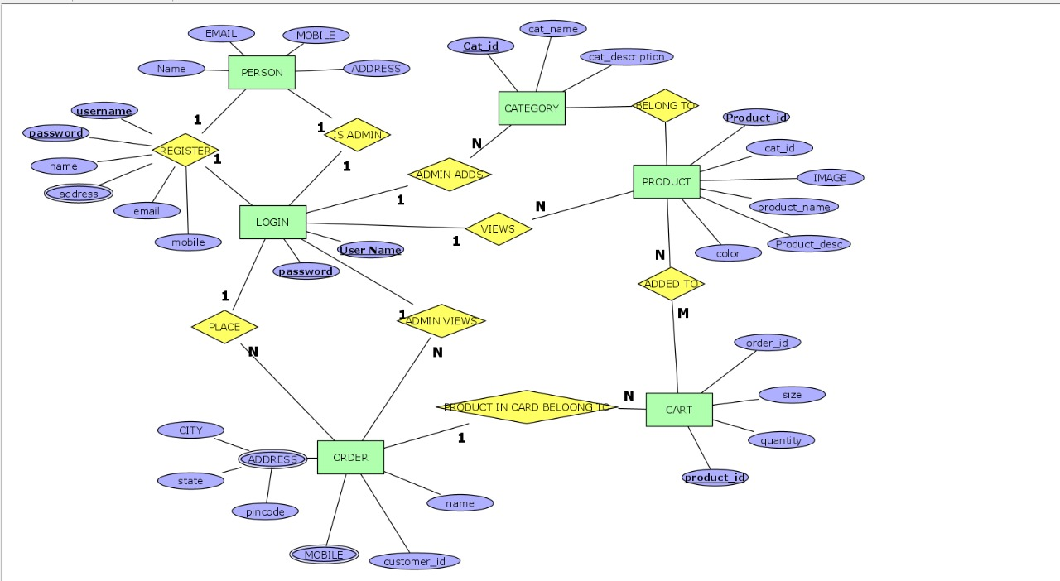
ER-Diagram

Slide 8
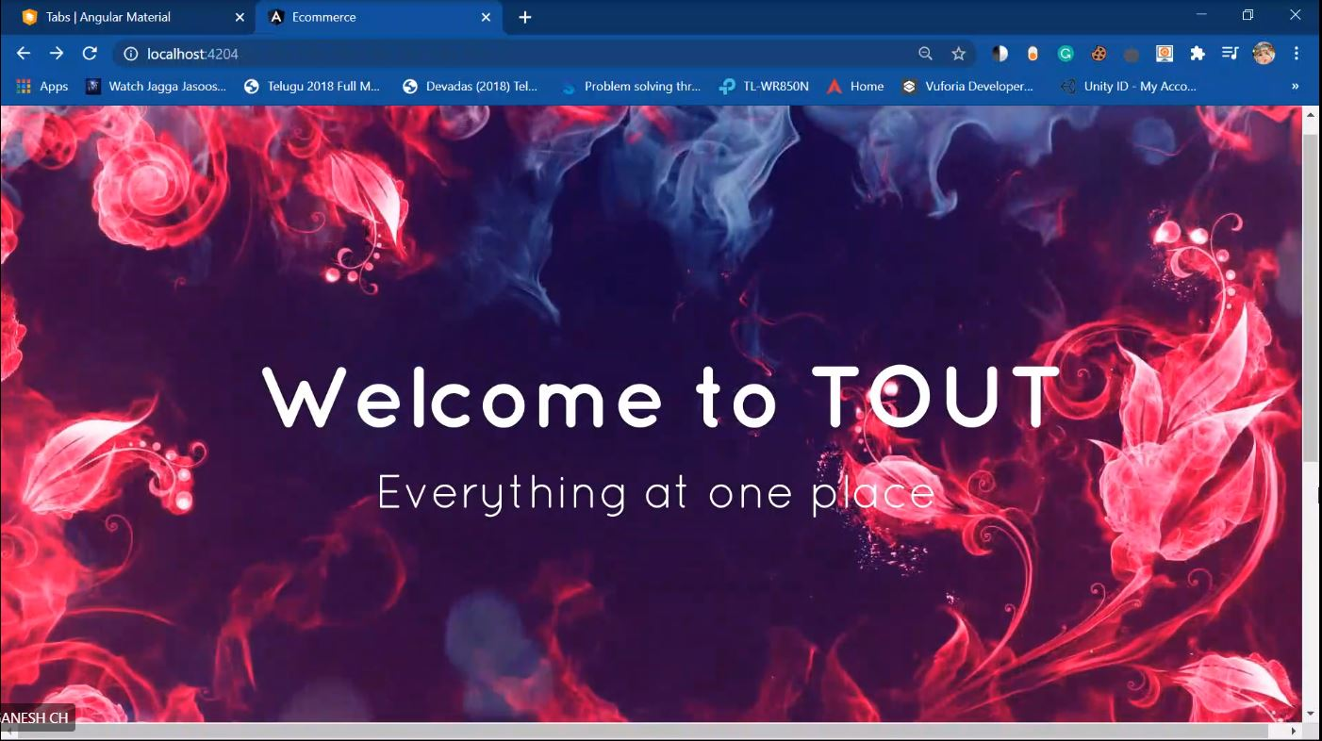
Home-Page:

Slide 9
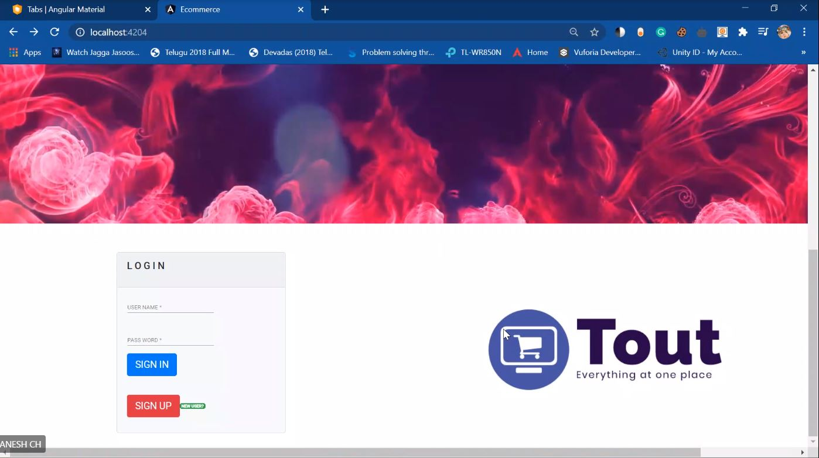
Home-Page:

Slide 10
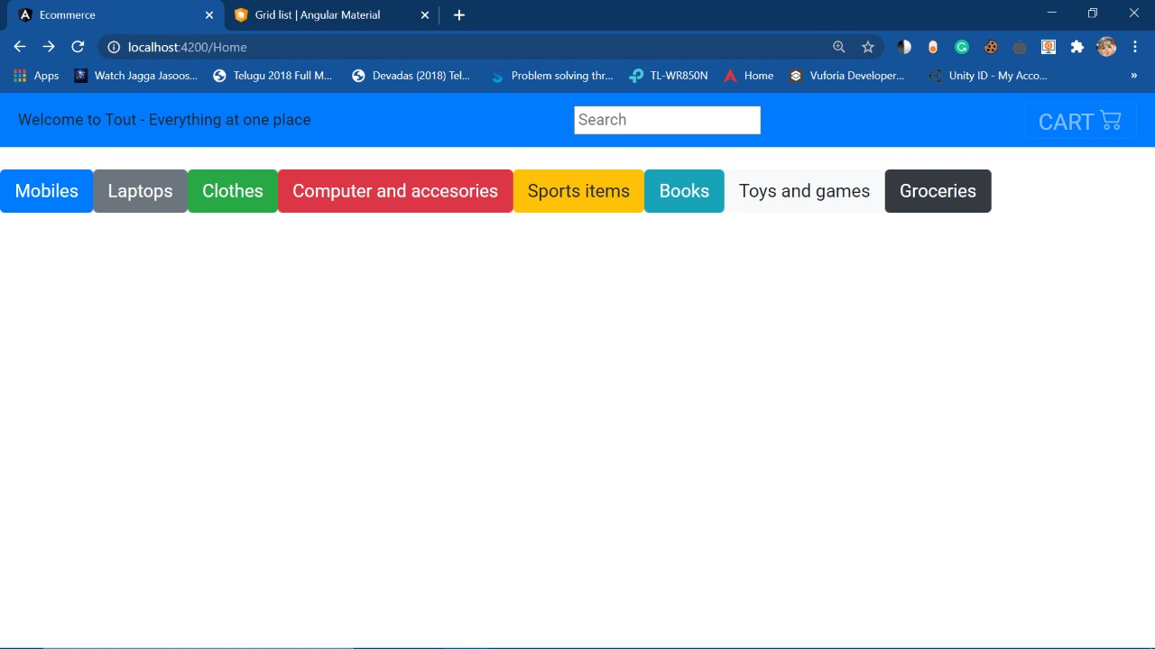
HOME Page:

Slide 11
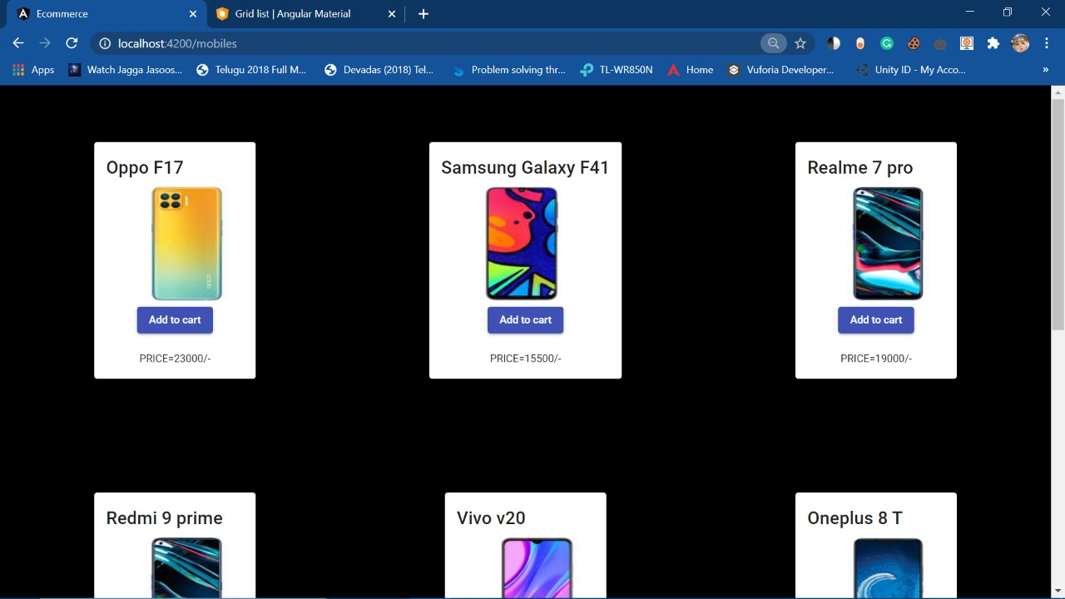
Products

Slide 12
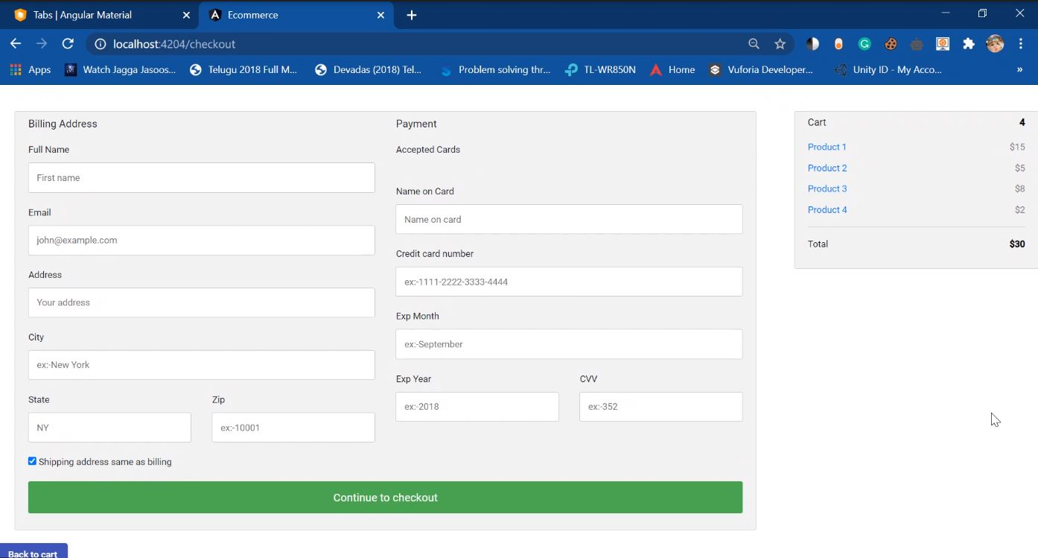
Cart page:

Slide 13
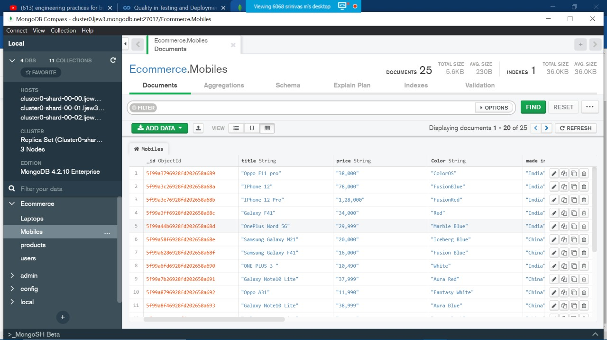
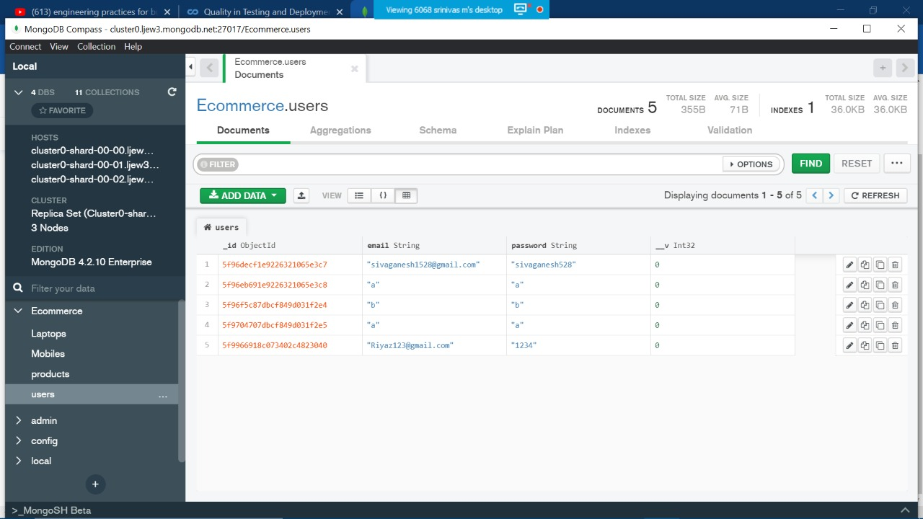
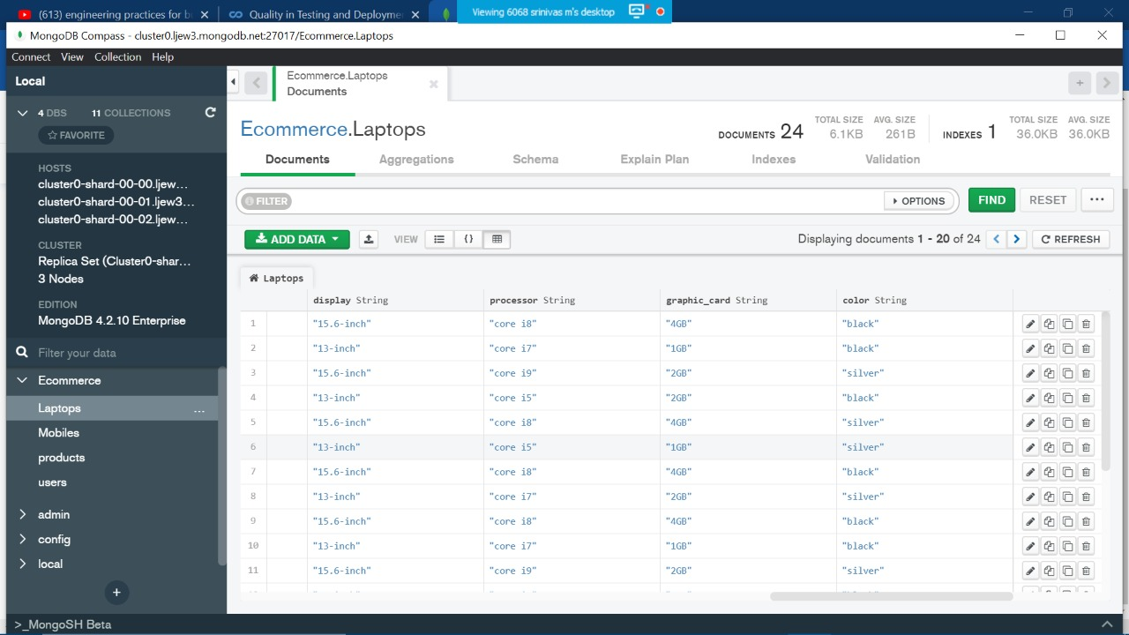

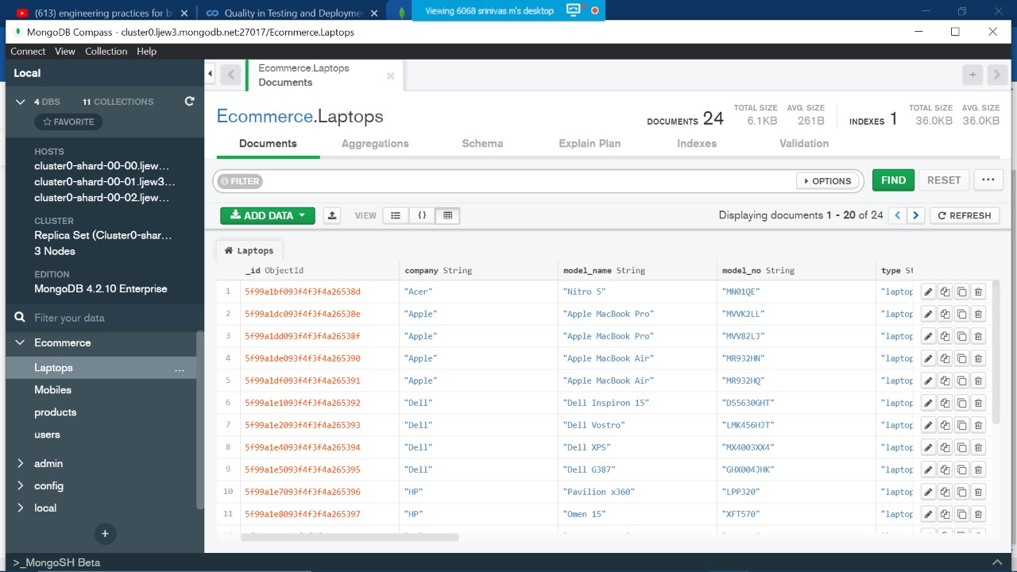
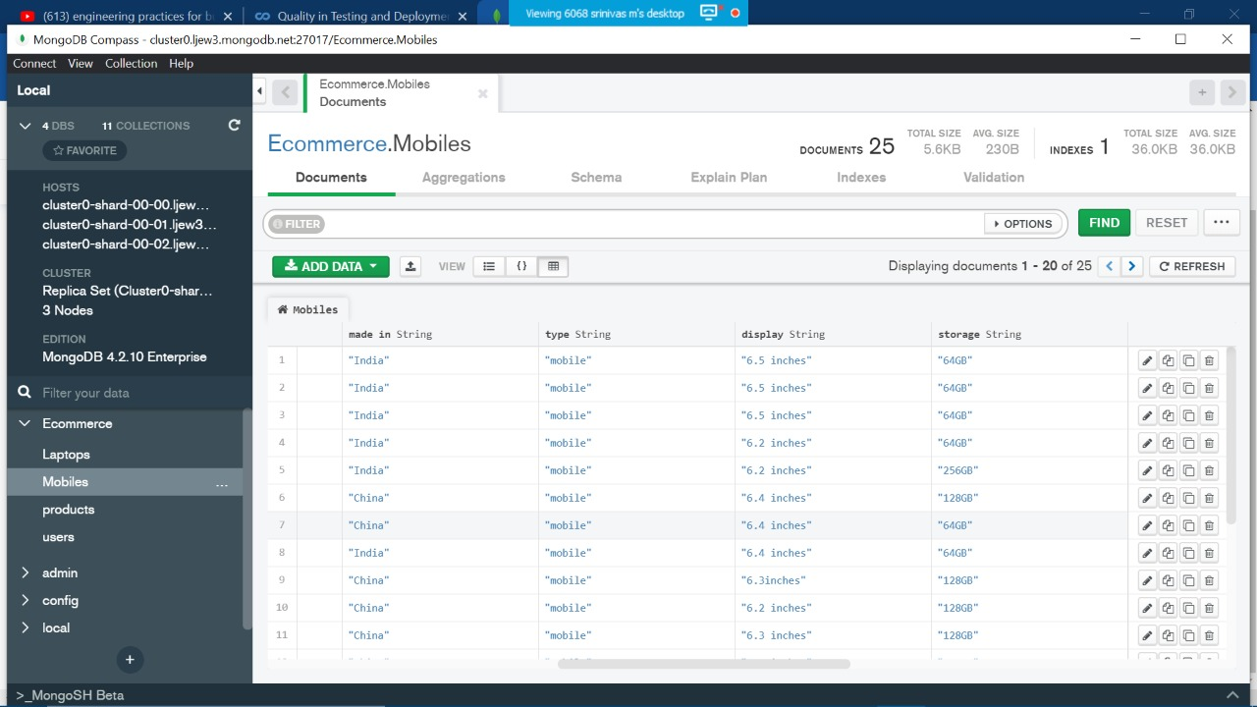

Slide 19


